Slide 1
Chapter 3

Slide 2

Problem-solving agent
Problem-solving agent
  A kind of goal-based agent
  It solves problem by
    finding sequences of actions that lead to desirable states (goals)
  To solve a problem,
    the first step is the goal formulation, based on the current situation

Slide 3
Goal formulation
The goal is formulated
  as a set of world states, in which the goal is satisfied
Reaching from initial state → goal state
  Actions are required

Slide 4
Problem formulation
The process of deciding
  what actions and states to consider
E.g., driving Amman → Zarqa
  in-between states and actions defined
  States: Some places in Amman & Zarqa
  Actions: Turn left, Turn right, go straight, accelerate & brake, etc.

Slide 5
Search algorithm
Defined as
  taking a problem
  and returns a solution
Once a solution is found
  the agent follows the solution
  and carries out the list of actions – execution phase
Design of an agent
  “Formulate, search, execute”

Slide 6
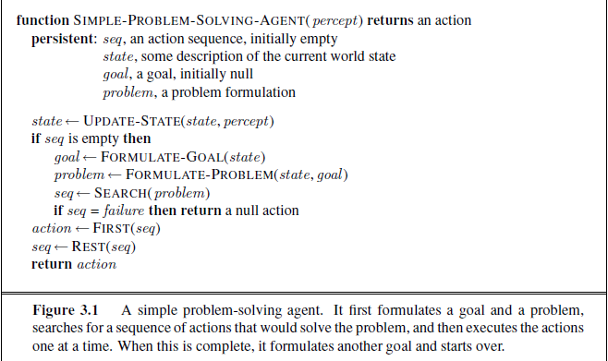

Slide 7
Well-defined problems and solutions
A problem is defined by 5 components:
Initial state
Actions
Transition model or
(Successor functions)
Goal Test.
Path Cost.

Slide 8
Well-defined problems and solutions
A problem is defined by 4 components:
  The initial state
    that the agent starts in
  The set of possible actions
  Transition model: description of what each action does.
  state space
    the set of all states reachable from the initial state by any sequence of actions.
  A path in the state space:
    any sequence of states connected by a sequence of actions.

Slide 9
Well-defined problems and solutions
The goal test
  Applied to the current state to test
    if the agent is in its goal
  -Sometimes there is an explicit set of possible goal states. (example: in Amman).
  -Sometimes the goal is described by the properties
    instead of stating explicitly the set of states
  Example: Chess
    the agent wins if it can capture the KING of the opponent on next move ( checkmate).
    no matter what the opponent does

Slide 10
Well-defined problems and solutions
A path cost function,
  assigns a numeric cost to each path
  = performance measure
  denoted by g
  to distinguish the best path from others
Usually the path cost is
  the sum of the step costs of the individual actions (in the action list)

Slide 11
Well-defined problems and solutions
Together a problem is defined by
  Initial state
  Actions
  Successor function
  Goal test
  Path cost function
The solution of a problem is then
  a path from the initial state to a state satisfying the goal test
Optimal solution
  the solution with lowest path cost among all solutions

Slide 12
Formulating problems
Abstraction
  the process to take out the irrelevant information
  leave the most essential parts to the description of the states

Slide 13
Example: Romania
On holiday in Romania; currently in Arad.
Flight leaves tomorrow from Bucharest
Formulate goal:
  be in Bucharest
Formulate problem:
  states: various cities
  actions: drive between cities
Find solution:
  sequence of cities, e.g., Arad, Sibiu, Fagaras, Bucharest

Slide 14

Example: Romania

Slide 15
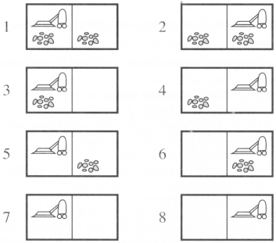

Toy problems
Example: vacuum world
Number of states: 8
Initial state: Any
Number of actions: 4
  left, right, suck, noOp
Goal: clean up all dirt
  Goal states: {7, 8}
Path Cost:
  Each step costs 1

Slide 16
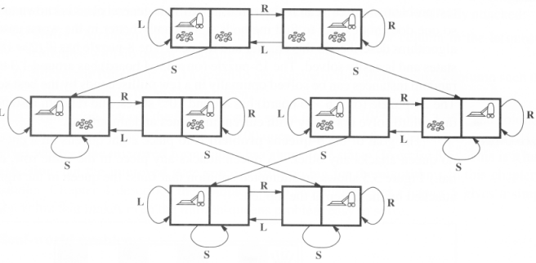

Slide 17
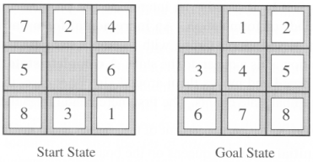
The 8-puzzle

Slide 18
The 8-puzzle
States:
  a state description specifies the location of each of the eight tiles and blank in one of the nine squares
Initial State:
  Any state in state space
Successor function:
  the blank moves Left, Right, Up, or Down
Goal test:
  current state matches the goal configuration
Path cost:
  each step costs 1, so the path cost is just the length of the path

Slide 19
The 8-queens
There are two ways to formulate the problem
All of them have the common followings:
  Goal test: 8 queens on board, not attacking to each other
  Path cost: zero

Slide 20
The 8-queens
(1) Incremental formulation
  involves operators that augment the state description starting from an empty state
  Each action adds a queen to the state
  States:
    any arrangement of 0 to 8 queens on board
  Successor function:
    add a queen to any empty square

Slide 21
The 8-queens
(2) Complete-state formulation
  starts with all 8 queens on the board
  move the queens individually around
  States:
    any arrangement of 8 queens, one per column in the leftmost columns
  Operators: move an attacked queen to a row, not attacked by any other

Slide 22
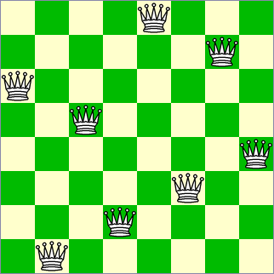
The 8-queens
Conclusion:
  the right formulation makes a big difference to the size of the search space

Slide 23
3.3 Searching for solutions

Slide 24

Tree search example

Slide 25

Tree search example

Slide 26
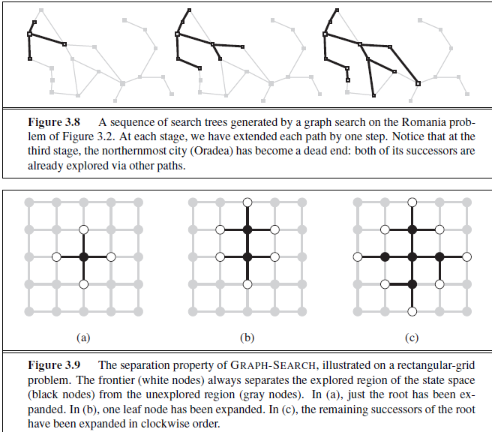


Slide 27
Search tree
A node n is having four components:
  n.STATE: which state it is in the state space
  n.PARENT-NODE: from which node it is generated
  n.ACTION: which action applied to its parent node to generate it
  n.PATH-COST: the cost, g(n), from initial state to the node n itself

Slide 28
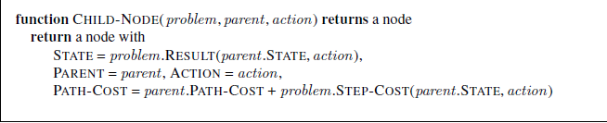

Slide 29
Measuring problem-solving performance
The evaluation of a search strategy
  Completeness:
    is the strategy guaranteed to find a solution when there is one?
  Optimality:
    does the strategy find the highest-quality solution when there are several different solutions?
  Time complexity:
    how long does it take to find a solution?
  Space complexity:
    how much memory is needed to perform the search?

Slide 30
Measuring problem-solving performance
In AI, complexity is expressed in
  b, branching factor, maximum number of successors of any node
  d, the depth of the shallowest goal node.
  (depth of the least-cost solution)
  m, the maximum length of any path in the state space
Time and Space is measured in
  number of nodes generated during the search
  maximum number of nodes stored in memory

Slide 31
Measuring problem-solving performance
For effectiveness of a search algorithm
  The total cost = path cost (g) of the solution found + search cost
    search cost = time necessary to find the solution

Slide 32
3.4 Uninformed search strategies

Slide 33
3.4 Uninformed search strategies
Uninformed search
  no information about the number of steps
  or the path cost from the current state to the goal
  search the state space blindly
Informed search, or heuristic search
  a cleverer strategy that searches toward the goal,
  based on the information from the current state so far

Slide 34
Uninformed search strategies
Breadth-first search
  Uniform cost search
Depth-first search
  Depth-limited search
  Iterative deepening search
Bidirectional search

Slide 35
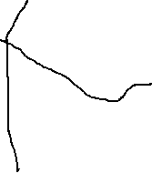
Example: Romania

Slide 36
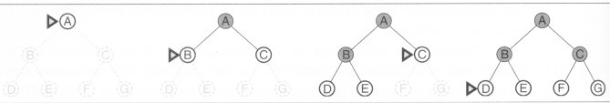
Breadth-first search
The root node is expanded first (FIFO)
All the nodes generated by the root node are then expanded
And then their successors and so on

Slide 37
Breadth-first search
S
A
D
B
D
A
E
C
E
E
B
B
F
11
D
F
B
F
C
E
A
C
G
14
17
15
15
13
G
C
G
F
19
19
17
G
25

Slide 38
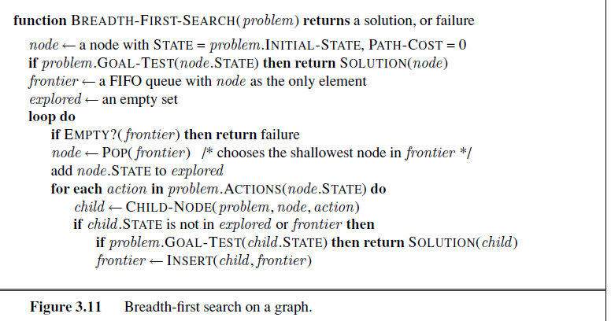

Slide 39
Properties of breadth-first search
Complete? Yes (if b is finite)
Time? 1+b+b²+b³+… +b^{d} = O(b^{d+1})
Space? O(b^{d+1}) (keeps every node in memory)
Optimal? Yes (if cost = 1 per step)

Slide 40
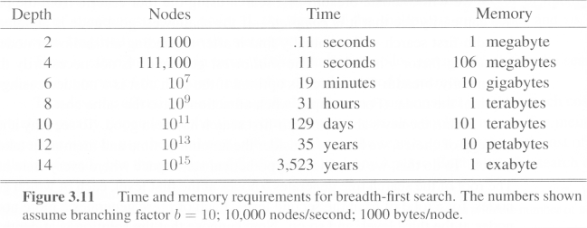
Breadth-first search (Analysis)
assuming 10000 nodes can be processed per second, each with 1000 bytes of storage
Space is the bigger problem (more than time)

Slide 41
Uniform cost search
Breadth-first finds the shallowest goal state
  but not necessarily be the least-cost solution
  work only if all step costs are equal
Uniform cost search
  modifies breadth-first strategy
    by always expanding the lowest-cost node
  The lowest-cost node is measured by the path cost g(n)

Slide 42
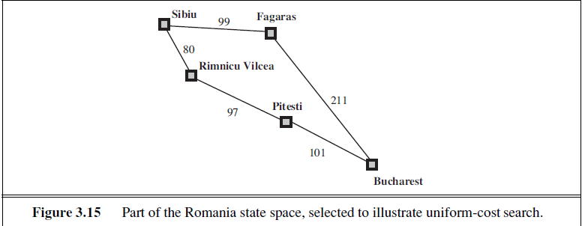
Uniform cost search
the first found solution is guaranteed to be the cheapest
  least in depth
  But restrict to non-decreasing (+ve) path cost

Slide 43
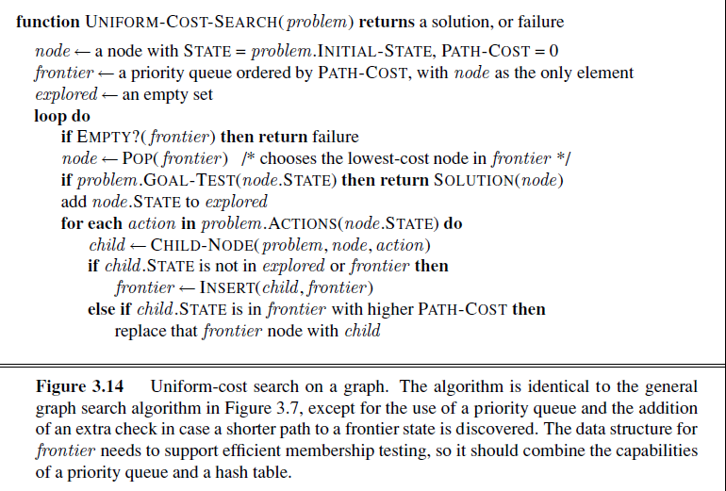

Slide 44
Depth-first search
Always expands one of the nodes at the deepest level of the tree
Only when the search hits a dead end
  goes back and expands nodes at shallower levels
  Dead end → leaf nodes but not the goal
Backtracking search
  only one successor is generated on expansion
  rather than all successors

Slide 45

Depth-first search
Expand deepest unexpanded node
Implementation:
  fringe = LIFO queue, i.e., put successors at front

Slide 46


Depth-first search
Expand deepest unexpanded node
Implementation:
  fringe = LIFO queue, i.e., put successors at front

Slide 47

Depth-first search
Expand deepest unexpanded node
Implementation:
  fringe = LIFO queue, i.e., put successors at front

Slide 48

Depth-first search
Expand deepest unexpanded node
Implementation:
  fringe = LIFO queue, i.e., put successors at front

Slide 49

Depth-first search
Expand deepest unexpanded node
Implementation:
  fringe = LIFO queue, i.e., put successors at front

Slide 50

Depth-first search
Expand deepest unexpanded node
Implementation:
  fringe = LIFO queue, i.e., put successors at front

Slide 51

Depth-first search
Expand deepest unexpanded node
Implementation:
  fringe = LIFO queue, i.e., put successors at front

Slide 52

Depth-first search
Expand deepest unexpanded node
Implementation:
  fringe = LIFO queue, i.e., put successors at front

Slide 53

Depth-first search
Expand deepest unexpanded node
Implementation:
  fringe = LIFO queue, i.e., put successors at front

Slide 54

Depth-first search
Expand deepest unexpanded node
Implementation:
  fringe = LIFO queue, i.e., put successors at front

Slide 55

Depth-first search
Expand deepest unexpanded node
Implementation:
  fringe = LIFO queue, i.e., put successors at front

Slide 56

Depth-first search
Expand deepest unexpanded node
Implementation:
  fringe = LIFO queue, i.e., put successors at front

Slide 57
Depth-first search
S
A
D
B
D
A
E
C
E
E
B
B
F
11
D
F
B
F
C
E
A
C
G
14
17
15
15
13
G
C
G
F
19
19
17
G
25

Slide 58
Depth-first search (Analysis)
Not complete
  because a path may be infinite or looping
Not optimal
  it doesn't guarantee the best solution
It overcomes
  the time and space complexities

Slide 59
Properties of depth-first search
Time? O(b^{m}): terrible if m is much larger than d
  but if solutions are dense, may be much faster than breadth-first
Space? O(bm), i.e., linear space!

Slide 60
Depth-Limited Strategy
Depth-first with depth cutoff k (maximal depth below which nodes are not expanded)
Three possible outcomes:
  Solution
  Failure (no solution)
  Cutoff (no solution within cutoff)

Slide 61
Depth-limited search
It is depth-first search
  with a predefined maximum depth
  maximum depth
    too small → no solution can be found
    too large → the same problems are suffered from
Anyway the search is
  complete
  but still not optimal

Slide 62
Depth-limited search
S
A
D
B
D
A
E
C
E
E
B
B
F
11
D
F
B
F
C
E
A
C
G
14
17
15
15
13
G
C
G
F
19
19
17
G
25

Slide 63
Iterative deepening search
No choosing of the best depth limit
It tries all possible depth limits:
  first 0, then 1, 2, and so on
  combines the benefits of depth-first and breadth-first search

Slide 64
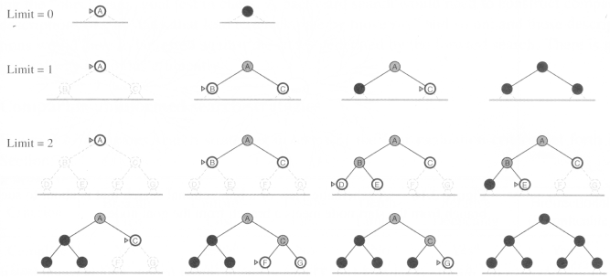
Iterative deepening search

Slide 65
Iterative deepening search (Analysis)
optimal
complete
Time and space complexities
  reasonable
suitable for the problem
  having a large search space
  and the depth of the solution is not known

Slide 66
Bidirectional search
Run two simultaneous searches
  one forward from the initial state another backward from the goal
  stop when the two searches meet
However, computing backward is difficult
  A huge amount of goal states
  at the goal state, which actions are used to compute it?
  can the actions be reversible to compute its predecessors?

Slide 67
Bidirectional Strategy
2 fringe queues: FRINGE1 and FRINGE2
Time and space complexity = O(b^{d/2}) << O(b^{d})

Slide 68
Bidirectional search
S
Forward
A
D
Backwards
B
D
A
E
C
E
E
B
B
F
11
D
F
B
F
C
E
A
C
G
14
17
15
15
13
G
C
G
F
19
19
17
G
25

Slide 69
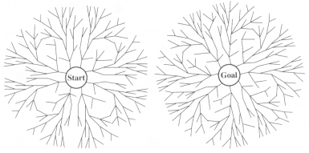

Slide 70
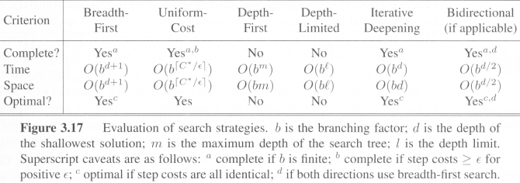
Comparing search strategies

